Slide 1
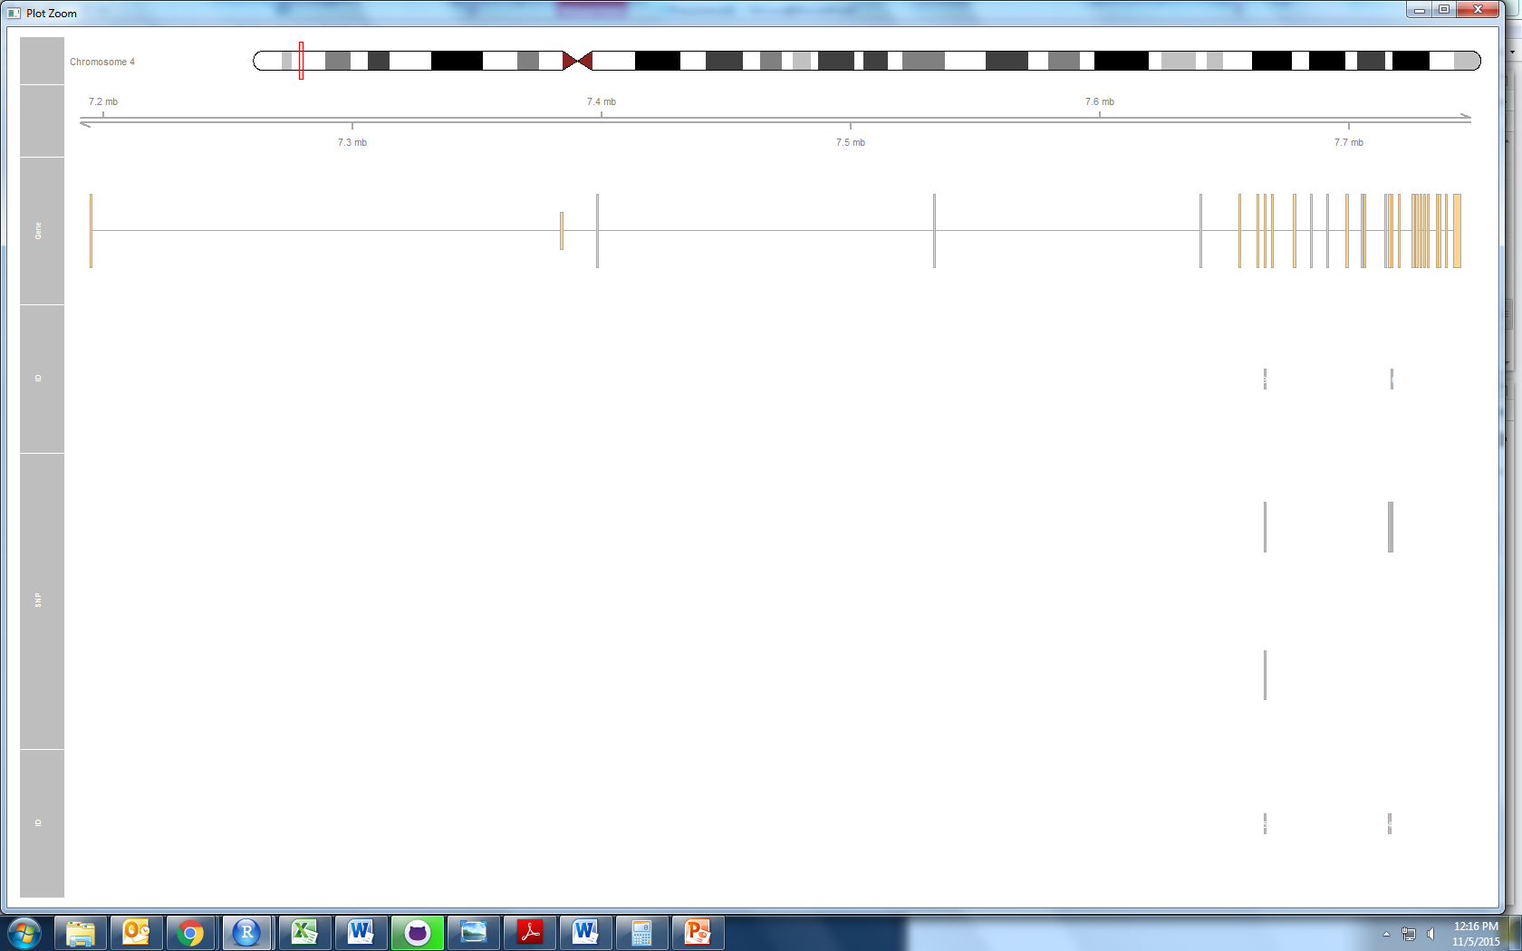
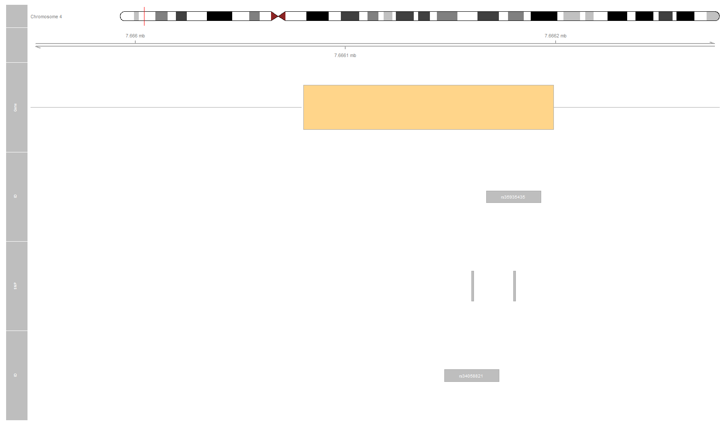
SorCS2
exon 7
exon 15
exon 16
rs34058821
rs35935435
rs16840892
rs6816604

